Slide 1
Hygieia Dashboad

Slide 2
Hygieia – a DevOps dashboard
DevOps dashboards are also an emerging need
All the tools in a single dashboard
Open Source

Slide 3
Why Hygieia
Every DevOps tool has its own dashboard
Jenkins has its own dashboard
Git, Jira has atlassian dashboard
Code quality has sonar dashboard
No common dashboard where everything can be presentable

Slide 4
Features
Team Dashboard: Monitor things like workitems, code repo, builds, quality items (unit tests, security, coverage, etc.), and deployments in one dashboard.
Real-time Status: Monitor quality, productivity, and work in process on a real-time basis within the dashboard.
Configurable View: Set up the dashboard to display the widgets that matter most to your project, which helps amplify and shorten the feedback loop.
Open Source:Hygieia is open source and free for everyone to use. We also encourage external users to commit to the project.

Slide 5
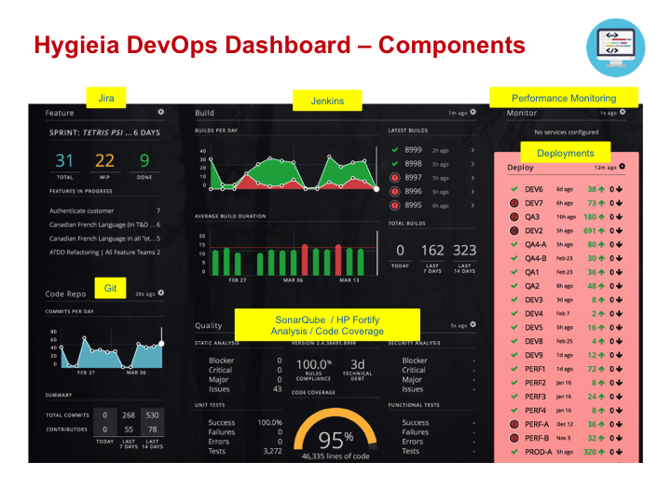
Components

Slide 6
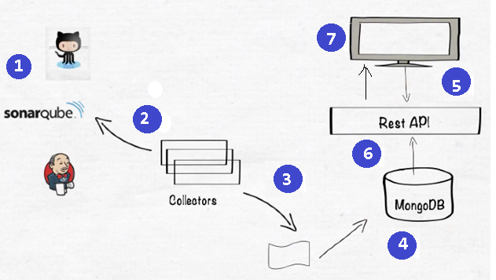
Hygieia Architechtire

Slide 7
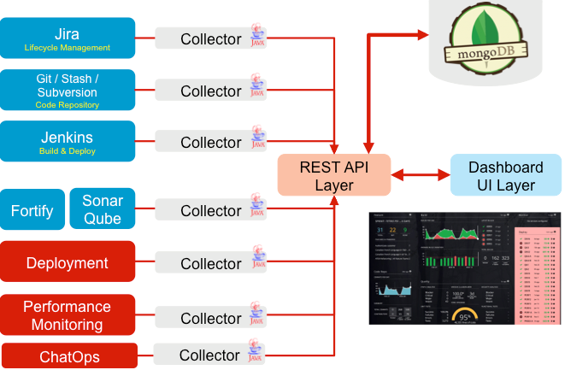

Slide 8
API Layer
API is work as an Interface between Collector and UI
Request: this package classes are used to store Request details
Rest : this package classes contains Controller classes
Service : this package classes are used for send response to UI

Slide 9
Collector Layer
Each and every DevOps Tool having their own collector. For example Jenkins tool having its own collector call it as Jenkins Build Collector.The main job of the collector is, it will collects the Data from DevOps tool and save that data into the MongoDB
Build Collectors
Cloud Collectors
Deploy Collectors
Feature Collectors
SCM Collectors:

Slide 10
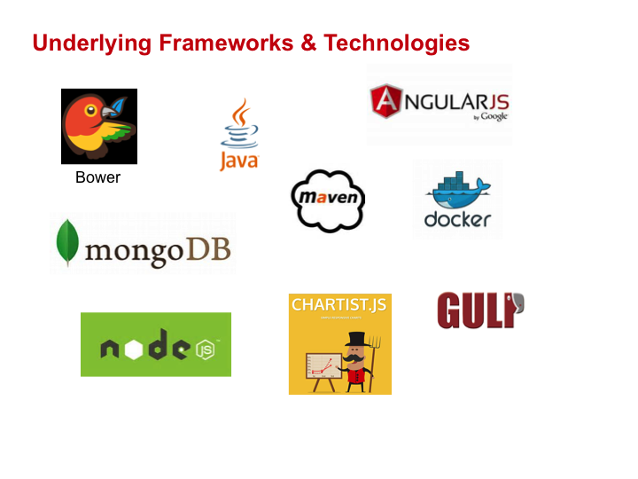
Technology Stack Used

Slide 11
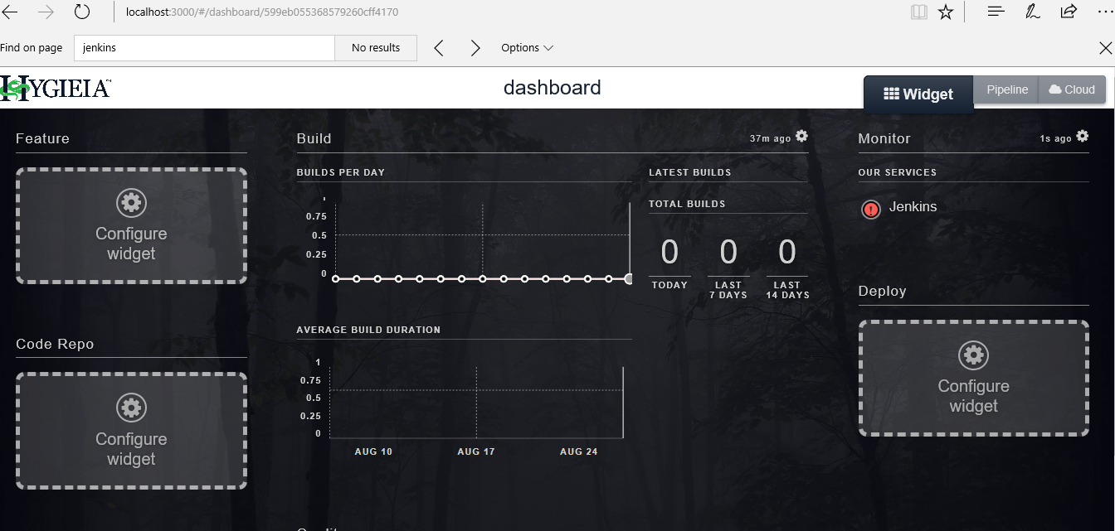
How It works

Slide 12
Q& A

